Slide 1





Hospitality Analysis Dashboard
Analyzing hotel bookings, revenue, occupancy and customer performance using Excel, Tableau, Power BI & SQL
Team Members:
Ashish Raj
Yash Mundhe
Manjiri Ingale
Yash Satpute
Aditya Borkar

Slide 2
Tools Used:
Excel → Data analysis & PivotTables
Tableau → Interactive visualization
Power BI → Interactive dashboard & KPI analysis
SQL → Data querying & KPI validation

Slide 3
Project Objective:
The main objective of the project was to transform raw hotel booking data into meaningful business insights.
Analyze Revenue Performance
Evaluate revenue generated across hotels, dates and booking channels.
🏨 Measure Hotel Performance
Analyze occupancy, ADR, RevPAR and other key performance indicators.
👥 Understand Booking Behavior
Identify trends across booking platforms and room categories.
❌ Analyze Cancellations & No-Shows
Understand their impact on hotel revenue and operations.
💡 Support Business Decisions
Convert data into actionable insights and recommendations.
Goal: Enable data-driven decision-making through interactive dashboards and SQL-based analysis.

Slide 4
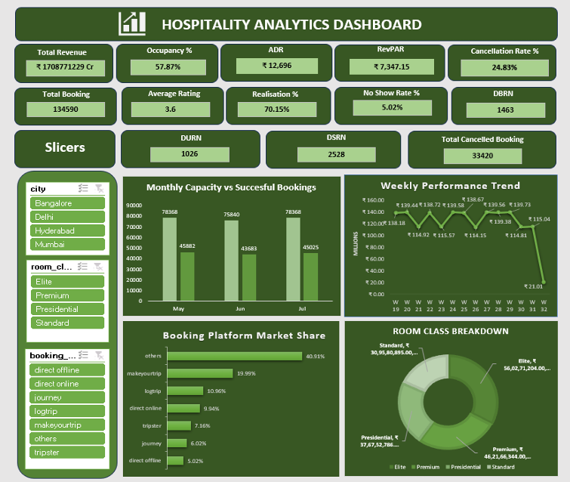
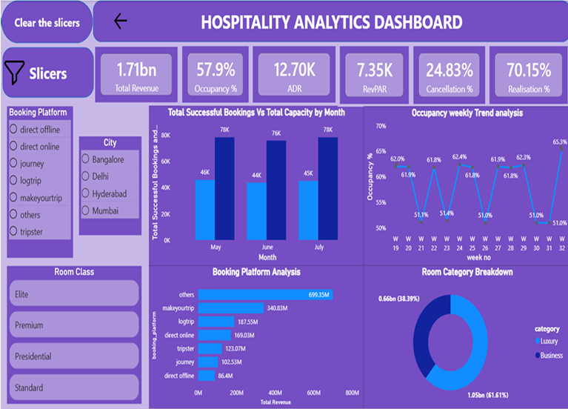
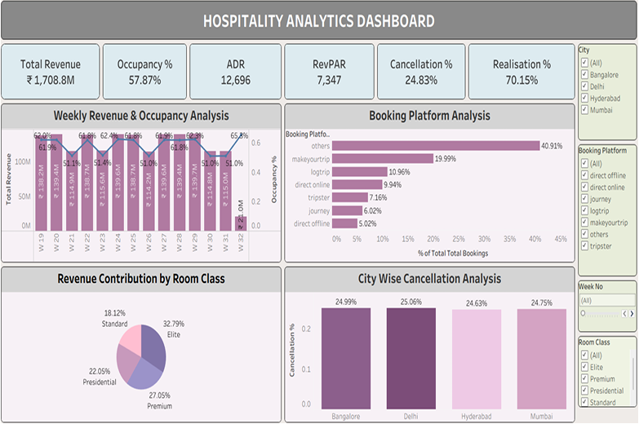
Dashboards & SQL Analysis:
Excel Analysis
PivotTables, KPIs & trend analysis
Power BI Dashboard
KPI monitoring & interactive analysis
Tableau Dashboard
Interactive hotel performance visualization

Slide 5
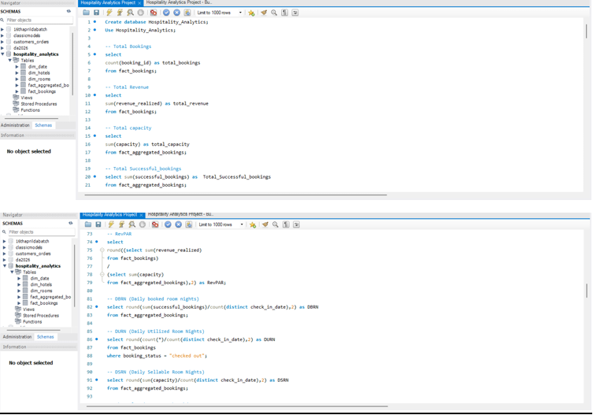
SQL Analysis
Data validation & KPI calculations

Slide 6
Challenges Faced:
Challenge: | Solution:
Inconsistent date formats - | Converted and standardized dates into proper DATE format
Data relationship issues - | Created appropriate relationships between dimension and fact tables
KPI calculation inconsistencies - | Validated calculations across Excel, Power BI and SQL
Large booking dataset - | Used PivotTables, SQL queries and aggregated tables for efficient analysis
Dashboard filtering issues - | Reviewed relationships and filter interactions
Data quality issues - | Performed NULL and duplicate checks before analysis
Key Learning: Data preparation and validation were as important as visualization.

Slide 7
Business Insights:
💰 Revenue
₹1.71 Billion
The hotels generated approximately ₹1.71B in realized revenue during the analysis period.
🏨 Occupancy
57.87%
Overall occupancy was approximately 58%, indicating significant scope to improve room utilization.
❌ Cancellation
24.83%
Nearly one-fourth of bookings were cancelled, representing a potential revenue and capacity management concern.
⭐ Customer Rating
3.62 / 5
The average rating indicates moderate customer satisfaction, leaving room for service improvement.
👥 No-Show
5.02%
No-shows accounted for around 5% of bookings and can negatively affect room availability and revenue planning.
💵 RevPAR
₹7,347.15
RevPAR indicates the revenue generated per available room and provides a useful measure of overall room performance.

Slide 8
Recommendations:
1. Reduce Cancellation Rate
Introduce flexible but structured cancellation policies and incentives for confirmed stays.
2. Improve Occupancy
Use targeted promotions during low-demand periods and optimize room pricing based on demand.
3. Reduce No-Shows
Introduce booking confirmation reminders and advance-payment/deposit options for selected bookings.
4. Improve Customer Experience
Analyze low-rated stays and identify recurring service issues to improve customer satisfaction.
5. Optimize Booking Channels
Compare performance across booking platforms and focus marketing spend on channels generating stronger realized revenue.
6. Data-Driven Monitoring
Use Power BI/Tableau dashboards for continuous monitoring of revenue, occupancy, ADR, RevPAR and booking trends.

Slide 9
THANK YOU!!!

